Slide 1
Mitchell Lake Association
Annual Meeting
Thursday, September 21, 2017

Slide 2
Agenda
Introductions of Current MLA Board
MLA Background Information
2017 Year in Review
Guest Speakers
  Leslie Stovring
  Shari Lackey
Business Meeting
  Financial Report
  Election of New Board Members
2018 Plans

Slide 3
MLA Board Members
Dave Jackett, President
Dan Dorst, VP, Acting Treasurer
Coco Duckstad, Secretary
Peter Iversen, CAC Representative
Frank Spahn (job relocation - open)
John Tyler
Michael Casanova
Kevin Persinger
Cheri Nehl
* We will be electing board members to fill open positions later this evening.

Slide 4
MLA Board Opportunities
4 Open Board Member Positions
  If you are interested, give your name to Carol Duckstad before 8:00 tonight.
Board member roles:
  3 year term, 4 meetings/year
  Support MLA activities
  Interface with partners (EP/WD District)
  Good opportunity to get involved
Notes:
Chairman: Before any organization can have a formalized meeting, it is necessary to have individuals who will act as the chair, secretary, parliamentarian, treasurer and tellers—if a paper ballot is needed. As we are not officially organized the steering committee accepted this responsibility and appointments to fill these positions were made.

Slide 5
Background Information
First Meeting March 2006
Association Founded September 2006
MLA is now 11 years old with 100+ members
Formed partnerships with:
  Citizens/property owners (Lakeshore Res, etc)
  Watershed District
  City of Eden Prairie (Education/Rain Gardens)
  Community Action Committee (CAC)
  Other Lake Associations (Riley, Lotus etc.)

Slide 6

Purpose
To create awareness, knowledge and appropriate actions with property owners, local government and community agencies to enhance water quality and thereby the boating, fishing and aesthetic values of Mitchell Lake.
Strategies
Improve the Quality of “in lake” water
Improve the Quality of Storm water run-off
Filter water flowing into the lake with natural buffers
Measures:
Levels of Phosphorous
Levels of Chlorophyll
Sechie Disk (water clarity)
“We aren’t what we ought to be. We aren’t what we’re going to be. We aren’t what we want to be. But, thank God, we aren’t what we were.”
~ Anonymous

Slide 7
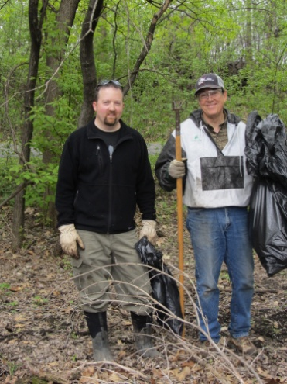
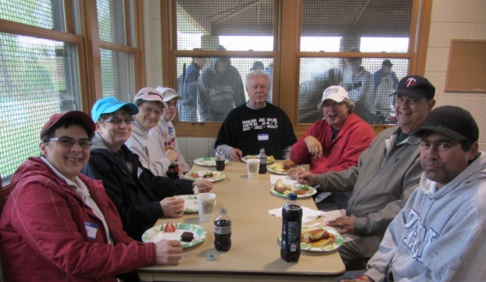
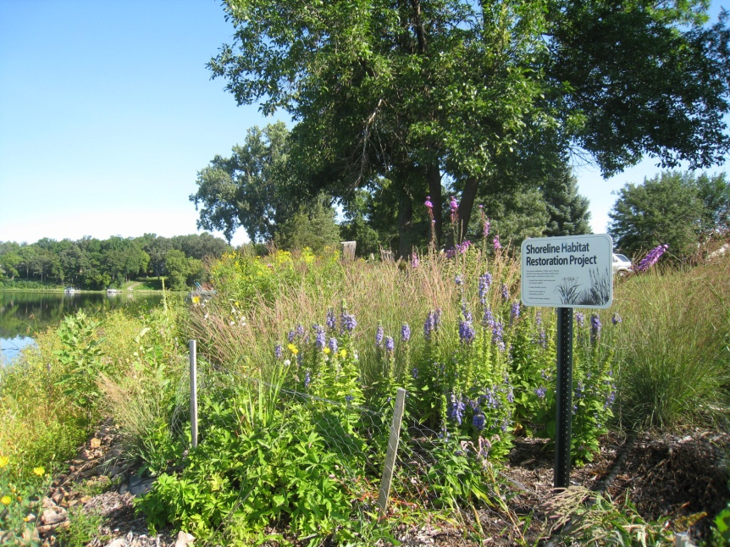
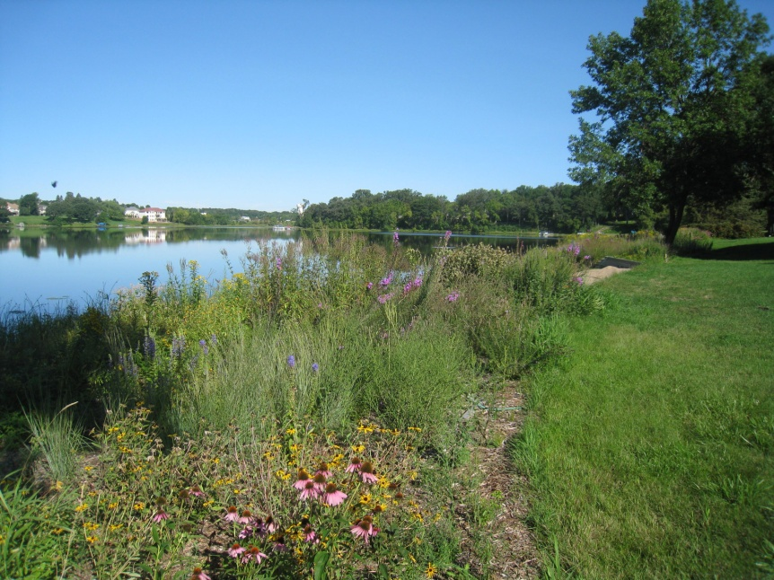
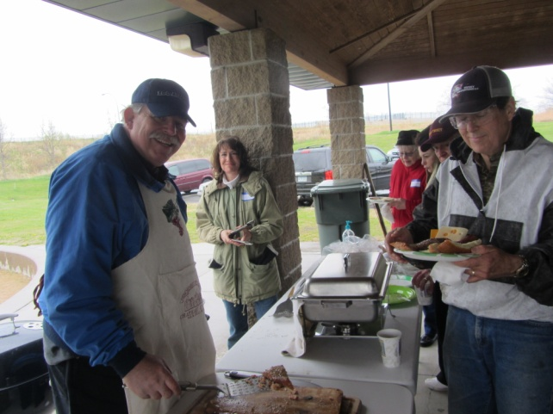
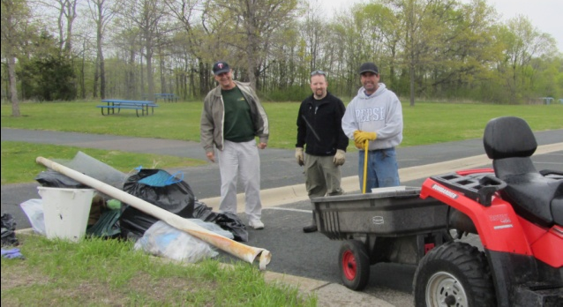

Over the Years…
11 lakeshore cleanup events
$33,000 DNR grant
>1,000 ft of lakeshore restored
Planted >100 trees along Hwy 5
Installed bird houses
Built community through fun events (BBQ etc.)
Hosted water stewardship training events
Monitored lake water and invasive species
Advocated with City and Watershed
Notes:
7

Slide 8
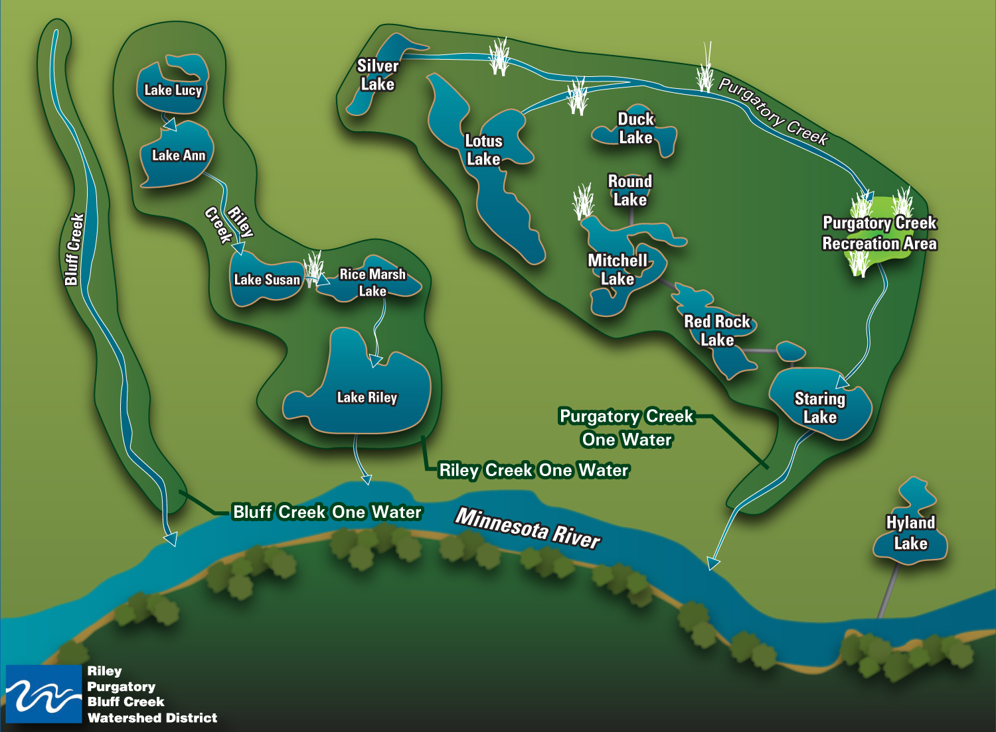
Watershed District

Slide 9


Partnership (City & Watershed)
Aquatic Invasive Species Boat Inspections
Annual herbicide treatments
Weed harvesting (association rebate)
Water quality monitoring
Lakeshore restoration grants (assoc. grant)
Rain barrel initiatives
Storm drain marking

Slide 10
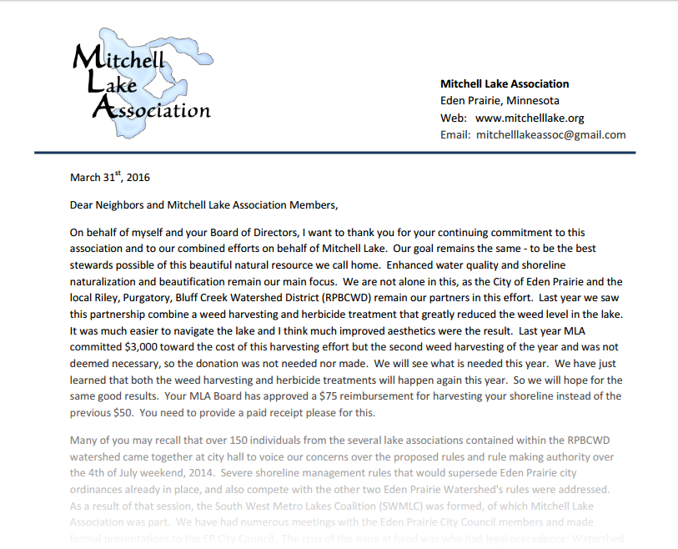
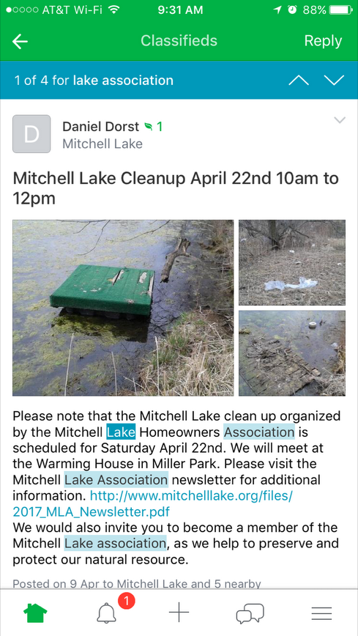
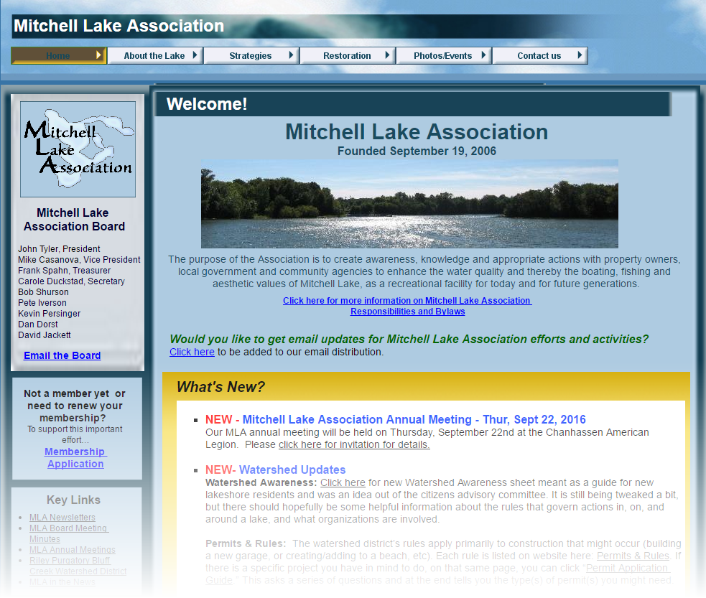
Communication
Annual newsletters
Website (www.mitchelllake.org)
Facebook NEW
Survey NEW
Nextdoor NEW
Newsletter
Facebook
Nextdoor
Website
Notes:
10

Slide 11

Mitchell Lake Association
2017
Year in Review

Slide 12
2017 Objectives
Host 11th annual lake cleanup
Assist in Continued Education for Lakeshore Restoration, rain gardens and barrels
Continue to actively participate with the Watershed District, CAC and SWMLC
Weed Harvesting ($ grant)
Support lakeshore restoration efforts ($ grant)
Push/research for reclassification
Continued AIS Inspections
Mark storm drains
Increase awareness and membership

Slide 13
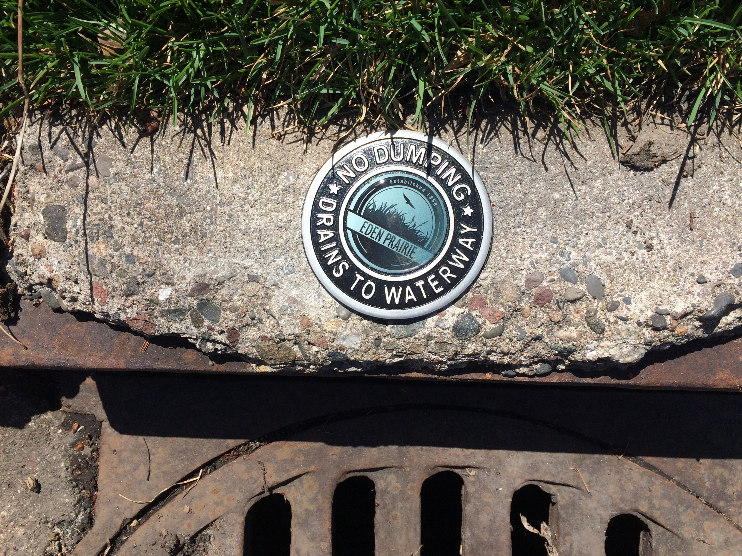
Storm Water Drain Marking
Did you know that whatever goes into our storm sewers travels untreated into our lake?
Help project our water by marking drains to help educate neighbors
City of EP provides drain marking kits
In April, 2017, John and Mikayla Capouch installed markers on all storm drains along Island Road, South Bay Curve and and Weston Bay Road
THANK YOU!!!

Slide 14
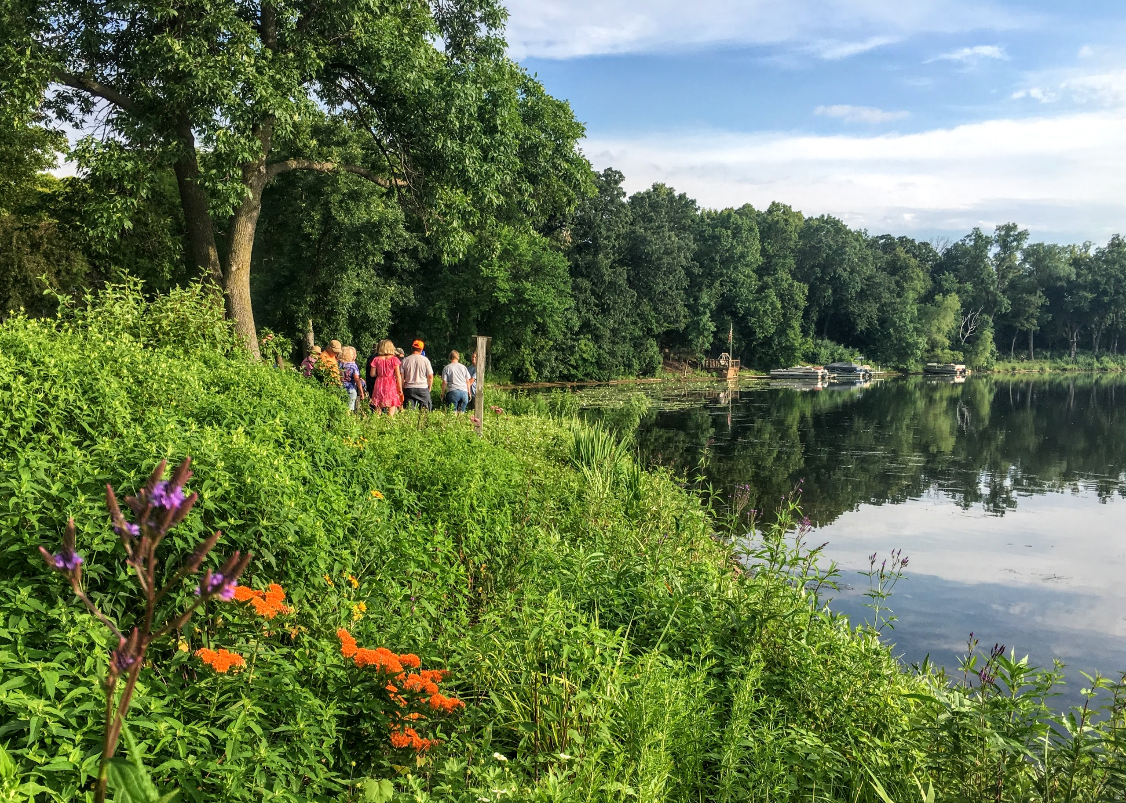
Shoreline Maintenance Workshop
MLA & RPBC Watershed District hosted a shoreline maintenance workshop on June 29th, 2017.
Tracy Lawler from Natural Shores Technologies provided hands-on instruction to a group of 18 participants with respect to plant identification and best practices for eliminating weeds.

Slide 15
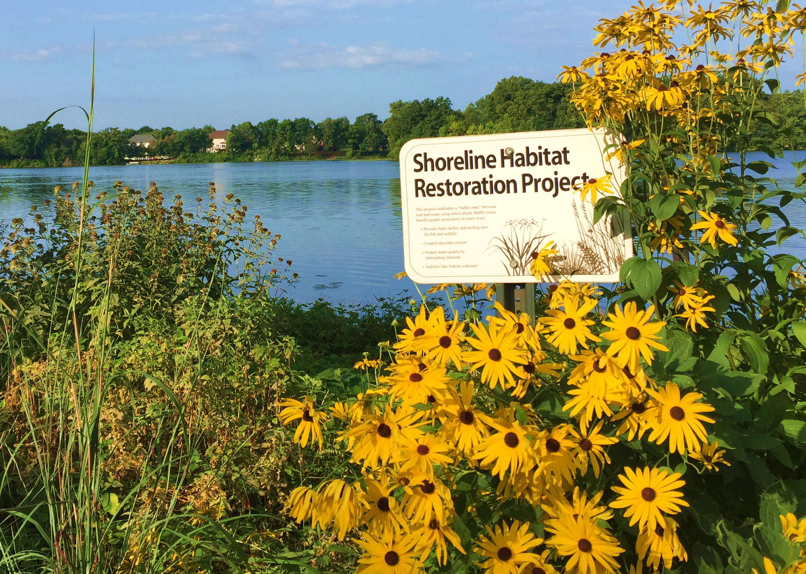
Shoreline Restoration/
Rain Garden Rebates
Shoreline buffers and rain gardens improve water quality by capturing pollutants
Watershed and City of EP offer rebate programs.
New in 2017 – MLA began offering $250 rebates to MLA members that complete a Watershed or City of EP approved project.

Slide 16
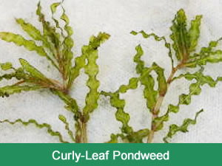

Shari Lackey
Master Water Steward
President, Timber Lakes Homeowners Assoc.
Hennepin County Aquatic Invasive Species (AIS) Early Detection Program .
.

Slide 17

Leslie Stovring
Environmental Coordinator, City of Eden Prairie
President, Timber Lakes Homeowners Assoc.
Mitchell Lake Restoration Efforts
& Sustainable EP Program .

Slide 18
Business Meeting
2016 Annual Meeting Minutes
Treasurers Report – Dan Dorst
Elections - 4 open board seats
      Frank Spahn – moved away
      Coco Duckstad – term expired
      Kevin Persinger – term expired
      Mike Casanova – term expired
  New board members encouraged!

Slide 19
Elections
Candidate Introductions
Background
Why are you interested in running?
Elections
Check 4 names on the ballot

Slide 20
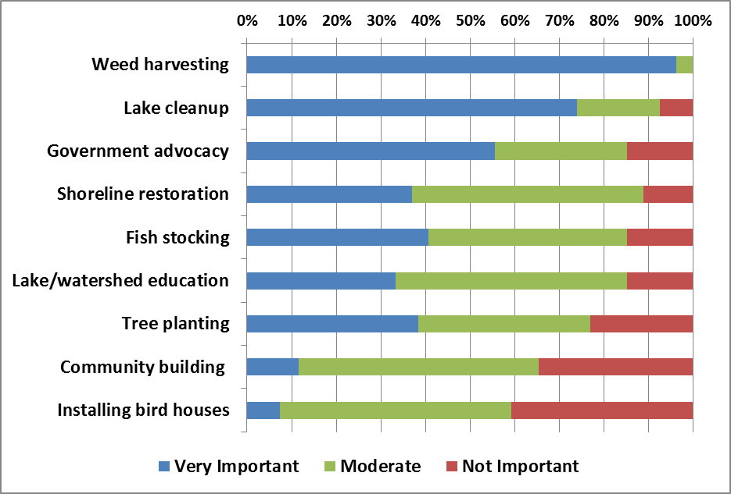
What would you like to see in 2018?
From
January 2017 Survey
28 responses
Current Plans
Focus Projects (for discussion)
  Goose Control
  North Bay Weeds

Slide 21
Thank You!!!
Our Association Board members
Frank Spahn…for his years of service
Dan Dorst & Cheri Nehl…for elevating communications
Members…for your contributions & support
Our speakers…for your commitment to Mitchell Lake
!! DOOR PRIZE DRAWING !!

Slide 22
PLEASE Volunteer
WITHOUT VOLUNTEERS WE CAN NOT BE EFFECTIVE
Sign up sheets are located at the exit

